Slide 1
Job Framework Redesign Employee Listening Session
October 2018
INDIANA UNIVERSITY
Notes:
Hello and welcome. My name is XXXXX and I would like to introduce my colleagues who will be helping in answering your questions during our discussion today.
We are excited to see all of you. This is our second Listening Session topic. Remember we are sharing as we continue our journey with the build out of the new Job Framework.
The purpose of the Listening Sessions is to share with you “real” time what we are working on. Your questions will help shape our thinking and work as we build out the framework.
At the end of the session if you have comments and questions and would like to leave them with us, we would appreciate it. We have blank note cards (passed out) for you to write down a question for us to consider as part of our FAQs on our website or if you comment we welcome those as well. You can leave the card in a basket on your way out.

Slide 2
Today’s Discussion
Job Framework Elements
Job Functions/Job Families
Career Levels
Role Titles
Role Descriptors
Putting It All Together
Top 10 Takeaways
Next Steps
Q&A
Notes:
Here’s today’s topics for our discussion: go through the topics.
We will talk about the Job Framework elements in detail.
We have a couple of examples to take you through.
Our top 10 takeaways are the top 10 things we want employees to know and understand about the project.
We will talk a little about our next steps and then allow time for you to ask questions.

Slide 3
The Job Framework
SECTION 1

Slide 4
The Job Framework
Our Goal: To create a job framework that is clear, consistent, and transparent empowering staff employees to navigate “what’s next” in their career journey.
The new framework will provide:
A way for employees to make informed decisions about advancing their career – whatever that might mean for them
Tools for employees to see how their job relates to others jobs across the University to explore career and development opportunities
Tools for managers to make informed decisions about pay, advancement, and development opportunities for their employees
Notes:
By now we are hoping all of you have visited our website?
As a reminder, for those of you that haven’t had a chance, we encourage you to check it out as we continue to add new definitions, Q&A, events and other updates. It’s a key place for communications related to the new Job Framework.
As a reminder for those of you who attended our Spring session and for those of you who didn’t -- the most important elements of our new design are:
Simplicity
Transparency
Consistency
The end goal is for employees to be able to search and see jobs across the University as part of determining “what’s next” for them when thinking about a career at IU - whether it’s staying in a current job or preparing for a different or new job. You will be able to see how jobs relate to one another, what skills and competencies are important to that particular job, the level of the job, and the qualifications necessary for the role.
The whole idea is for you to be able to better understand what skills and development are required for your current role or a new role, which can help guide discussions with your manager about your development.

Slide 5
Job Framework Elements
SECTION 2

Slide 6
Job Framework Elements
The Job Framework will be organized by Job Functions and Job Families. This platform will help guide career progression.
Job Function
Job Family
Every staff employee will have a new:
Career Level
Job Title
Role Descriptor
Salary Range
Notes:
We will talk about each of these elements today and go through examples. If you were at our Spring listening session or have been on our web site you may already be familiar with a couple of these elements like Job Function and Job Family. We will talk about it briefly again so everyone is on the same page, and then move into helping you understand career levels, new job titles and share an actual example of the new role descriptor.

Slide 7
Job Framework Elements
The roles within the Job Framework will be organized by Job Functions and Job Families. This platform will help guide career progression.
What is a Job Function?
A broad grouping of roles with a similar nature of work – e.g. Finance, Information Technology, or Student Services
What is a Job Family?
A more specific specialty within a Job Function
Specific roles and career progressions will be part of the Job Framework based on the identification of Job Families
Notes:
This is a good reminder for those of you that were here in the Spring. For those of you that are new to our sessions, organizing jobs by Job Function and Job Family is a standard way to organize and group jobs. It is a common “best practice” when creating job structures.
Job functions and job families will be used to organize all jobs across the University. We will discontinue the use of the labels “professional”, “support staff” and “service”. Jobs within the Job Functions and Job Families will be placed into either a:
Non-exempt job structure or jobs eligible for Overtime or
Exempt job structure or jobs not eligible for Overtime
Think of Job Function as the large category and Job Family as the sub-category or more specific specialty. These are not specific to a Responsibility Center, Department or School.
Example: Job Function: Student Services/Job Family: Financial Aid

Slide 8
Job Framework Elements
What is a Career Level?
Used to describe the level of a role based on (for individual contributors):
Functional knowledge
Problem Solving and Complexity
Autonomy and Decision Making
Scope and Impact
Leadership and Influence
What is a Career Evolution?
Movement to a different role with the same or different job family based on skills, competencies, and experience
Notes:
Career level defines the level of job. Think of the career level as a career band with many roles or jobs from different functions and families. The roles within a career level have similar attributes based on work dimensions which are:
Functional Knowledge
Problem Solving and Complexity
Autonomy
Decision Making
Scope and Impact
Leadership and Influence
These will be described and embedded in the role descriptors based on Career Level. The language used to describe the work dimensions is intended to capture what would be typical for that level of work. The language is not specific to any function/family/job.
Note: Functional Knowledge speaks to the level of understanding (knowledge) necessary to be successful in the role based on the work performed.
The work dimension categories were identified based on research into career leveling at peer institutions and organizations, as well as third-party survey leveling.
A career evolution could be within the same family or could be a different family or even a different job function. It can be same or different level. When you think about this in the context of “transferrable” skills, it creates many more options for you to consider and what those possible next moves might be.
Think about your career as a lattice or jungle gym versus a ladder. When you think about your career in terms of a ladder it limits your opportunities. What if you had the ladder leaning up against the wrong wall?

Slide 9
Job Framework Elements
What is a Role (Job) Title?
A role title is created for every role and is used to describe the role in a general way
Using consistent role titles across the university creates a common language for understanding how each role fits into the job framework
What is a Role Descriptor?
A summary of the most important aspects of a job, including a brief summary of duties and responsibilities with career/job level details
Creates a foundation for career development
Notes:
As we have mentioned, in most cases positions will have new “system” titles. We will allow working titles with certain guidelines by level if employees choose to use them with their supervisor and HR business partner’s approvals. The working titles will be more commonly used for business cards and/or email signatures. We will not be maintaining working titles within the HR systems. We will talk through an example in a minute.
The creation of new titles gives us an opportunity to create more consistency for “like” roles and provide a common language. It helps us better understand how jobs are related across the University. This becomes most important when you think about making a career move.
Let’s talk about the role descriptor. This will replace the position descriptions we have in place today, which are very specific for every employee. The biggest difference and really a “mind shift” is that the role descriptors will focus on the role versus being focused and very specific to an individual. They are intended to describe the primary purpose and responsibilities of roles/jobs, not the specific, unique tasks defined by a supervisor that may vary from position to position.
The role titles and role descriptors as part of the new design are intended to represent accountabilities and responsibilities of the role not the individual or any specific position.
This enables us to better assign a salary range reflective of what other companies/organizations/higher education institutions pay for similar roles.

Slide 10
Job Framework Elements
What are Career Levels, Career Progression, and Role Titles?
1
Non-Exempt – Individual Contributor
Title Descriptor: Coordinator
Foundational | Intermediate | Mastery
2
Exempt – Individual Contributor
Title Descriptor: Specialist
Core | Career | Advanced | Expert
3
People Leader
Title Descriptor: Leader
Operational | Senior Operational | Strategic
Job Title Naming Convention: Job Family plus Title Descriptor unless marketplace has a different standard – e.g. Financial Analyst, Nurse, etc.
Notes:
As we have mentioned before this is a pictorial view of our new career levels and structures. There are three career structures: Non-Exempt Individual Contributor, Exempt Individual Contributor, and Exempt Supervisor/Management—or what we’ll call People Leader. You also can see that there is overlap between the three streams, which is intentional.
The three structures are not intended to be linear, as careers are not linear, but rather a lattice or jungle gym as we have mentioned. It’s important not to get too caught up in what your new career level will be as long as it generally describes the level of work for the role you are performing. With each role being assigned a salary range more closely aligned with the market, you could and most likely will have situations where a job at the Mastery level of the non-exempt Individual Contributor structure would be priced higher than a role at the Core level of the exempt Individual Contributor structure depending the job.
As we shared on previous slides, the Career Levels are defined by work dimensions. They are slightly different for individual contributors versus supervisory/management.
This visual also demonstrates how we plan to create consistency among titling within the new Job Framework. In general, the system title will be the Job Family name plus the title descriptor as labeled above. For example, if the role is in the Student Services Job Function, the Job Family is Financial Aid, and the role is non-exempt, the title will be Financial Aid Coordinator.

Slide 11
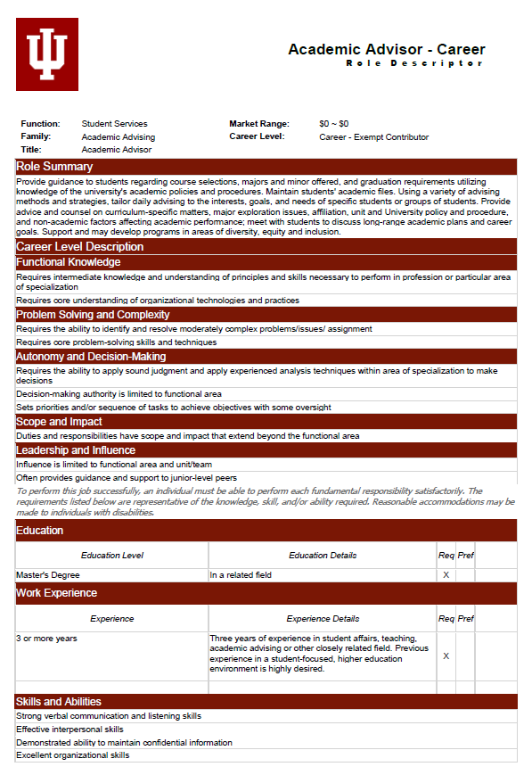
Job Framework Elements
What are the components
of the new Role Descriptor?
Notes:
The IUHR Compensation Programs team is responsible for creating the initial working draft of the role descriptors to ensure consistency across the University. We will reach out to either HR partners or other business partners to seek input on the role descriptors as they are developed. We think that the vetting process may look different depending on job family, so it’s difficult to give specific details. We won’t be able to vet (get feedback on) every role descriptor with every HR Business Partner or every stakeholder given the timeline.
Walk through each element of the Role Descriptor elements:
We will have Function, Job Family, Title, Market range, and Career Level at the top of every role descriptor. The role descriptors in the Job Framework will be able to be accessed by all employees internally or by perspective employees externally via our website.
Role Summary: This is the high level “descriptor” of the job that captures the essence of the role – why the role exists. It’s very general. It may or may not be different from career level to career level.
Career Level Description: This will be the same for all roles in the same career level and in this example you can see the dimensions we talked about earlier.
For Education, Work Experience and Skills and Abilities: Typical minimum requirements will be indicated and consistent across the same role at the same level

Slide 12
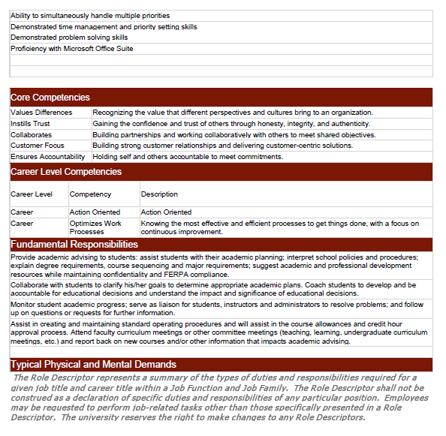
Job Framework Elements
What are the components
of the new Role Descriptor?
Notes:
Core Competencies: We will be rolling out a competency model to employees with information regarding the core competencies initially – followed by competencies by career level once the job framework is fully operational.
The development of competency tools with ties to the job framework, recruiting, employee development, etc. will be ongoing over the next 12-24 months. More to come on this at a later date.
What is the definition of competencies?
Competencies are observable skills and behaviors that contribute to workplace success. They provide a common language around “how we do our jobs” at Indiana University. IU has selected five core competencies that will be applicable to all staff roles at IU and additional competencies for each career level.
Fundamental Responsibilities: These will be approximately 5-8 bullet points to capture the primary responsibilities of the role and will vary by career level. We look at the fundamental responsibilities as the essential duties and/or responsibilities performed in a role at a given career level (unlike current position descriptions, this is not intended to capture all tasks that a specific position may be expected to perform).
Typical Physical and Mental Demands: Describes the typical physical and mental demands necessary to perform a given role.

Slide 13
Job Framework Example
Background for Sally Smith
Work History: IU employee for 3 years
Education: Bachelor’s degree in Finance with a minor in Communications
Current Job Function: Student Services
Current Job Family: Financial Aid
Current Role: Financial Aid Specialist
Current Job Level: Core (IC Exempt)
Career Goals: Gain more experience in either Student Services area, Finance or Marketing/Communications
Notes:
Meet Sally Smith
Let’s look at Sally’s background and career goals

Slide 14
Job Framework Example
What are Sally’s Possible Career Options?
1
Same Function & Family Different Career Level Role (if role available)
Financial Aid Specialist – Career Level
OPTION
2
New Job Family/Same Level
Admissions/Recruitment Core Level
OPTION
New Function/Family
Job Function: Finance
Job Family: Financial Analysis
New Role: Financial Analyst Core Level
3
OPTION
Notes:
Sally begins to look at her options via the job framework tool. Here are three potential options that Sally finds and could consider (there could be more).

Slide 15
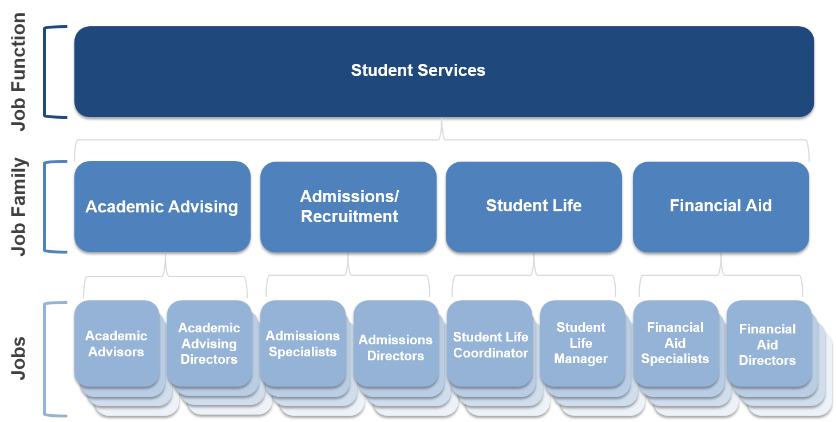
Job Framework Example
1
OPTION
What are Sally’s Possible Career Options?
Job Function
Same Function & Family Different Career Level Role
(if job available)
Financial Aid Specialist – Career Level
Job Family
Roles
Notes:
This is a pictorial view of what option 1 would look like. Sally would search via the Job Framework tool and find the Student Services Job Function. She would then look at the different Job Families.
She would select a job family and in this case it’s Financial Aid. She would see the role descriptor for the Financial Aid Specialist which would have a summary, career level with the work dimensions, and fundamental responsibilities to give her flavor the next level along with the experience, skills and competencies that are typically required.

Slide 16
Job Framework Example
2
OPTION
What are Sally’s Possible Career Options?
Job Function
New Job Family/Same Level
Admissions/Recruitment Core Level
Job Family
Roles
Notes:
Option 2.
It’s a similar search but this time Sally looks at a different job family and in this case it’s Admissions/Recruitment to see what jobs and levels are in the framework. She is either looking because there is an opening or she might be planning the next move in her career.
In this case she takes a look at the core level Admissions Specialist role and reviews the role descriptor.

Slide 17
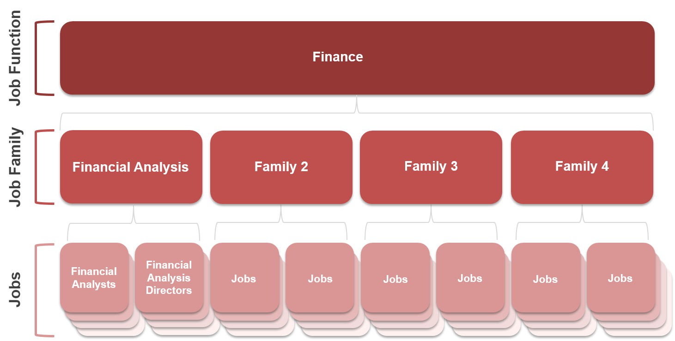
Job Framework Example
3
OPTION
What are Sally’s Possible Career Options?
Job Function
New Function/Family
Job Function: Finance
Job Family: Financial Analysis
New Role: Financial Analyst Core Level
Job Family
Roles
Notes:
In our third and final option, Sally explores a completely different job function and job family.
In this case, because Sally has a Finance degree and perhaps transferrable skills, she decides a role in the Finance function and Financial Analysis job family might be a good opportunity.
She then reviews the role descriptor to see if this might be a possible career move either now (if the role is currently posted) or in the future when the role is posted.
She will be able to learn what job requirements, skills and competencies are required and, by reading the Job Summary and Fundamental Responsibilities, she can determine if this is a role she might be interested in as part of her career plan.

Slide 18
Job Framework – Putting it All Together
Functions
Families
Roles
Role Descriptor
Student Services
Finance
Information Technology
Human Resources
Academic Advising
Admissions/Recruitment
Student Life
Financial Aid
Academic Coordinators
Academic Advisors
Academic Advising Leaders
Notes:
We are in the early stages of talking to our systems team about developing a tool by which employees, managers, and future employees would be able to view all the jobs in the framework and compare roles. This slide is an example of how the tool would work. We hope to have the ability to select more than one role at a time – we are thinking up to 3 roles. It would be like wanting to buy a car and you are not sure if you want to buy a Nissan, Toyota, or Kia.
This will be “one stop” shopping for thinking about your next career move, including the skills and abilities needed, type of experience necessary, competencies you might need to develop and even education, licenses or certifications that might be required for a given role.

Slide 19
Base salaries will not be affected by this project.
Jobs will not be eliminated and job duties will not change as a result of this project.
Benefits for employees in PAO positions will not change as a result of this project.
A modern job framework will replace the existing structures.
The approach of the job framework project is informed by research into other universities and employers.
Notes:
1. Base salaries will not be affected by this project.
Staff employee base salaries will not be reduced as a part of the Job Framework Redesign Project. In addition, there are no planned increases to employee base salaries as a part of the Job Framework Redesign Project.
2. Jobs will not be eliminated and job duties will not change as a result of this project.
Staff employee’s job duties will not change as a result of the Job Framework Redesign Project. Every staff employee will have a new role descriptor that includes the fundamental responsibilities of the job.
3. Benefits for employees in PAO positions will not change as a result of this project.
The PAO classification will not be a part of the new framework. These positions will become part of the non-exempt career structure. Staff employees currently classified as PAO will have their existing benefits grandfathered until they change roles. Whenever a staff employee moves into a new role, whether a lateral move or a promotion, they will assume the benefits for that new role (example: exempt vs. nonexempt benefits).
4. A modern job framework will replace the existing structures.
The existing classification structures for appointed staff at Indiana University are being retired and replaced with a modernized job framework that better aligns with best practices of universities and organizations. The new framework will be simple, more consistent, transparent, and will empower staff employees to determine their own career path or “next move” at IU. In addition, staff employees will be able to focus on skill development in their current role or in preparation for a new one.
5. The approach of the job framework project is informed by research into other universities and employers.
The framework is being built using third-party surveys to help inform appropriate functions, families, career structures, and career levels. These surveys represent many universities as well as the larger external job market that includes private and public organizations. Discussions with other universities and research of similar job framework projects informs communications strategies, terminology, and educational resources.

Slide 20
The new framework will update key components that help organize jobs.
Streamlined and consistent titles will help provide better insight into career opportunities at IU.
New role descriptors will focus on roles, not individuals.
Position reclassifications and updates continue, but will be frozen prior to the transition.
The ability for managers and HR business partners to request salary changes will continue in the new framework.
Notes:
6. The new framework will update key components that help organize jobs.
Staff jobs will be placed within the framework using new: Job Functions, Job Families, Career Levels, Salary Ranges, Job Titles, and Role Descriptors
7. Streamlined and consistent titles will help provide better insight into career opportunities at IU.
The new framework will have a streamlined and consistent titling structure across the university. Titles for similar roles will be aligned to better depict how jobs are related. This common language will help current and prospective staff employees more easily determine what their next career move might be.
8. New role descriptors will focus on roles, not individuals.
The new framework moves away from very granular, unique position descriptions focused primarily on individuals, and creates new role descriptors focused on the primary purpose of jobs.
Position reclassifications and updates continue, but will be frozen prior to the transition.
Position activity requests (significant updates, reclassification reviews, etc.) will continue to be reviewed while the new framework is being built. When implementation of the new framework nears, position classifications will need to be frozen and the IU HR Compensation team will no longer review or accept position activity requests.
10. The ability for managers and HR business partners to request salary changes will continue in the new framework.
Salary changes under the new framework can continue to be recommended by managers and HR business partners with the appropriate approvals.

Slide 21
Next Steps
Section 3

Slide 22
Job Framework Redesign – Next Steps
Continue creation and vetting of new role descriptors with key stakeholders across the University
Review and refine policies to align with new design
Watch for Future Sessions – Spring 2019
Notes:
Next Steps – lots of work to be done over the next year to get the job framework built. We hope that you now have a better idea of what the new framework will look like and what it means to each of you.
We will posting the job functions and families on our project website sometime in November. You will continue to have a way to ask questions via our Mach Form on the website.
We will be collaborating with our HR partners which are our key HR contacts in departments across the University and key stakeholders to get input on the role descriptions as we build them out. As mentioned earlier, the IUHR Compensation Programs team is taking the lead to develop the drafts to ensure consistency across the University.
We are utilizing our software to help us write and vet the role descriptors. Once we roll out the Job Framework you, as employees, will have access to not only your own role descriptor, but every role descriptor included in the framework.
As mentioned at the beginning of our session, we plan on another Listening Session in the Spring. Watch for more information on our website.
Thanks for coming today and for your questions.

Slide 23
Common Questions from the Live Sessions

Slide 24
My current job title is Coordinator. What is the likelihood that after my job duties are examined that my position is retitled in the system as “Specialist”?
Notes:
A: The system title will depend on the career structure (non-exempt individual contributor, exempt independent contributor, or people leader). If the position is currently non-exempt, the system title might remain “coordinator”. If the position is currently exempt, the system title would change since coordinator is a system title that will be used only for non-exempt independent contributor positions.

Slide 25
What if an individual moves from a formerly PAO position (non-exempt role) to an exempt individual contributor role and then goes back to a non-exempt role? What about a lateral transfer into the same non-exempt position (same duties/responsibilities) only in a different department—will the individual’s benefits change?
Notes:
A: Individuals who currently hold PAO positions will move into the non-exempt individual contributor career structure with grandfathered benefits so long as they remain in the position. If the individual moves into another non-exempt individual contributor role (even at the same level), the benefits offerings will change to be consistent with all other non-exempt individual contributor roles. If the individual moves into an exempt individual contributor role or an exempt people leader role the benefits offerings will not change and will be consistent with all other exempt roles. When a formerly classified PAO position becomes vacant, benefits will no longer be grandfathered to the position. Going forward, the position will be eligible for the same benefits offered to all other non-exempt individual contributor roles.

Slide 26
How much input will department leaders have in developing role descriptors? Especially for jobs that are unique to one specific department.
Notes:
A: The IUHR Compensation Programs team will have different approaches for developing role descriptors based on what makes the most sense for the job family. For most roles, IUHR Compensation Programs will take the lead on writing the first draft of the role descriptor. We will then work with stakeholders and business partners in departments, schools, RC’s, and across campuses to vet and get feedback on what we’ve drafted. We will work to make sure that we vet role descriptors with business partners and managers that support areas where there are numerous positions performing a given role (in other words, areas that could be considered “subject matter experts” for the role(s)). For roles that are very unique and/or specific, stakeholders, business partners, and/or managers may even reach to employees in these positions for feedback or information.

Slide 27
How will role titles work for positions that currently have associate director in the title, but are not primarily responsible for leading/managing people?
Notes:
A: Depending on the level of the role, there will be working titles that will be available to use with local HR and/or management approval in email signatures, business cards, etc. The purpose of creating new system titles is to bring consistency to titling for roles performing the same fundamental responsibilities. If the role is a higher level exempt independent contributor role, there will likely be flexibility to use Associate Director as a working title.

Slide 28
How will my role be classified if my job spans across multiple job families?
Notes:
A. The IUHR Compensation Programs team acknowledges and understands that “hybrid” roles exist across the university. When considering which function/family is most appropriate, we will be first thinking about the primary purpose of the role (why does it exist) to determine which function/family makes the most sense. If the role is truly 50/50 split between two functions (or families), we’ll work with stakeholders and business partners to make the best possible decision considering all factors. There is a possibility that we may need to create additional families to accommodate truly “hybrid” roles.

Slide 29
Visit the Job Framework Redesign Project Website:
http://hr.iu.edu/redesign/
Notes:
Thank you for taking the time to be a part of this recorded session. Please visit our Job Framework Redesign website.
If you have additional questions, there is a mach form on the project website that you can use to submit questions.
Be sure and watch for future communications announcing the Fall Listening Session and visit our website for updates.
Visit the Job Framework Redesign website:
http://hr.iu.edu/redesign/

